Slide 1
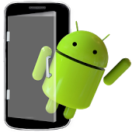

ANDROID APPLICATION
BUS LOCATOR

Slide 2


PROJECT PARTNERS
Swajan Rahman Chowdhury
Roll: 1407042
Department of CSE, KUET
Shovan Bhowmik
Roll: 1407050
Department of CSE, KUET

Slide 3


PROJECT ADVISORS
Bishnu Sarker
Assistant Professor Department of Computer Science & Engineering, KUET
Sk. Imran Hossain
Lecturer Department of Computer Science & Engineering, KUET

Slide 4
INTRODUCTION(1)
In the daily operation of bus transport systems, mainly that of buses, the movement of vehicles is affected by different uncertain conditions as the day progresses, such as:
Traffic Congestion
Unexpected Delays
Irregular Vehicle-dispatching times
Other incidents
Many students are late for classes because they decide to wait for the bus instead of just simply using an alternate transportation .
Besides many important works of people are not done just because they become unable to reach the spot in time.
Office going people are badly in need of this application

Slide 5
INTRODUCTION(2)
For such kind of problems, our app can give solutions, such as:
Our application focus on to providing them more convenience with bus schedules.
It provides real time bus location information so that they may not get delayed.
Also we have integrated google maps in the application.

Slide 6
OBJECTIVES
“Bus Locator Application” is an application for smart phones working on Android operating system.
This application uses the GPS function.
This application at a specific pickup point will send the current location of the bus to the people when they request.
This app generates predictions of bus arrivals at stops along the route.
This application uses a variety of technologies to locate any bus.

Slide 7

Users of our Application
Many people need this application for being timely to their works and other activities. So all the people related to regular public bus or school bus or university bus or local any vehicles can be benefitted by knowing the locations of the buses.

Slide 8
Requirements
Hardware Requirements
Ram: 512 MB or higher
Processor: 1 GHz or Higher
Memory: 150 MB or More
Others: GPS Enabled, Internet Connection
Software Requirements
Operating System: Android 4.0.0 or higher
Front-end: Android Studio
Back-end: Firebase
Plugins: Android SDK, ADT(Android Development Tools)

Slide 9
Development Environment
The proposed system requires Android Studio that is an open source software development environment
The Android project has been developed in the Android Studio 4.0.0, as it has plugins that are mainly used for android.
Android SDK: 1) Minimum Android SDK: Jelly bean 2) Compile SDK Version: 25 3) Build Tools Version “25.0.1”

Slide 10
Application Features
Multi-tasking App
Application used as Device
Bus Location Identification in Google Map
Distance Determination using Latitude & Longitude
Bus Route Information
Firebase DataBase Management

Slide 11
Application Permissions
Permission to internet
Permission to use GPS location
Permission to use Network location
Permission to modify data on Map

Slide 12
Application Main Module
Location Information
Map
Bus Route
Info

Slide 13
Work Flow & User Interface(1)
As there is no device available for our project we did the works of device in our app.
So basically our app has 3 options for users 1) For Bus Companies or bus Owners 2) For Bus Supervisors/Bus drivers 3) For general passengers
First of all, the bus companies will have to click “ADD BUS” options and then set their “username” & “password” which will be updated to the firebase database system. There one directory will be created as bus and owners will have to add “Bus Name”, “Bus no.”, “Bus Route” and unique “Password” . After submitting, these informations will be added to the directory. The interface of this point is in the next slide:

Slide 14
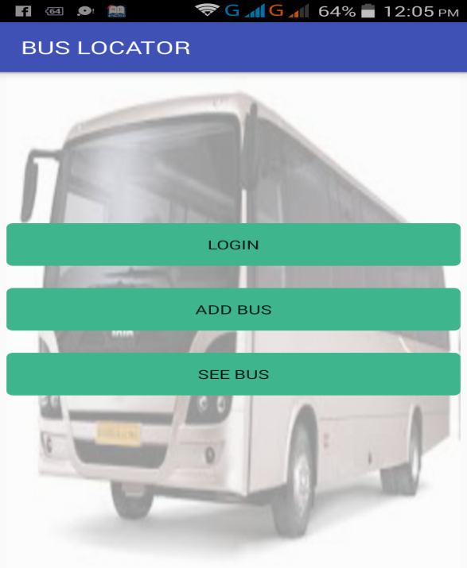
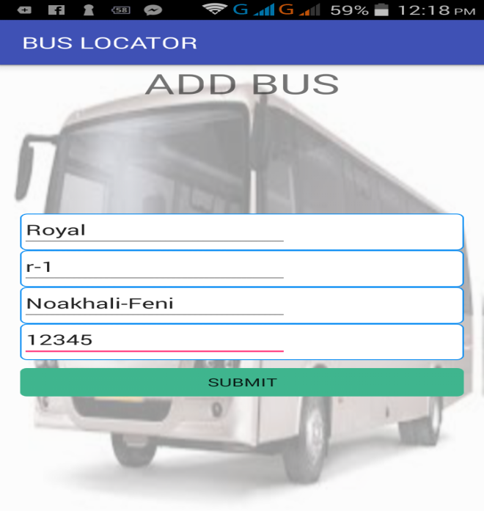
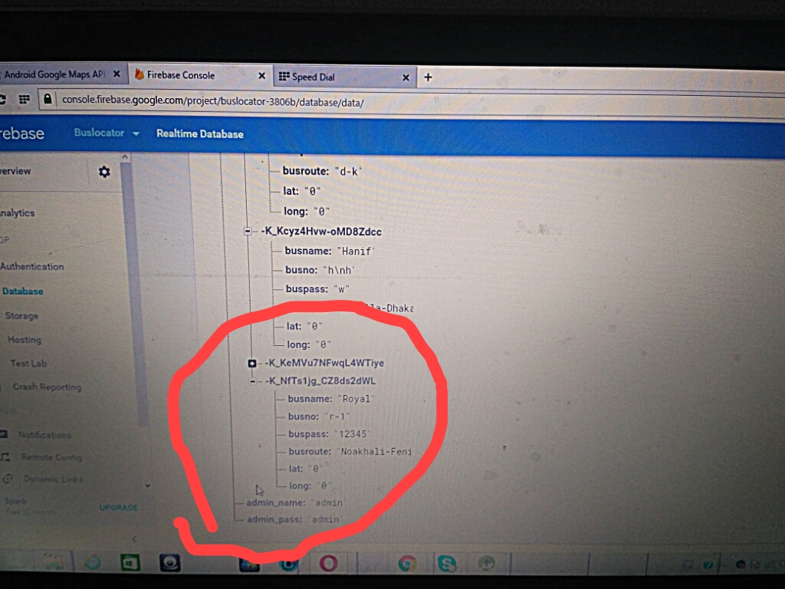
Work Flow & User Interface(2)

Slide 15
Work Flow & User Interface(3)
Then the bus supervisors or drivers will have to update the location of that specific bus by clicking on “LOGIN” option.
After clicking “Login”, the driver will update the location by setting “Bus Name”, “Bus No” and “Password”.
The longitude and Latitude will be updated also in the database system and also the map will be shown.
The interface of this point is in the next slide:

Slide 16

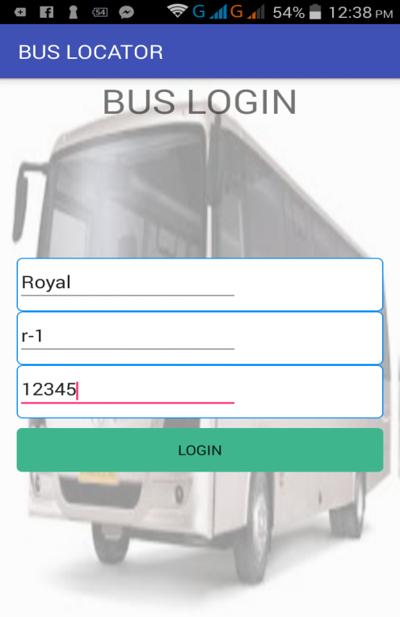
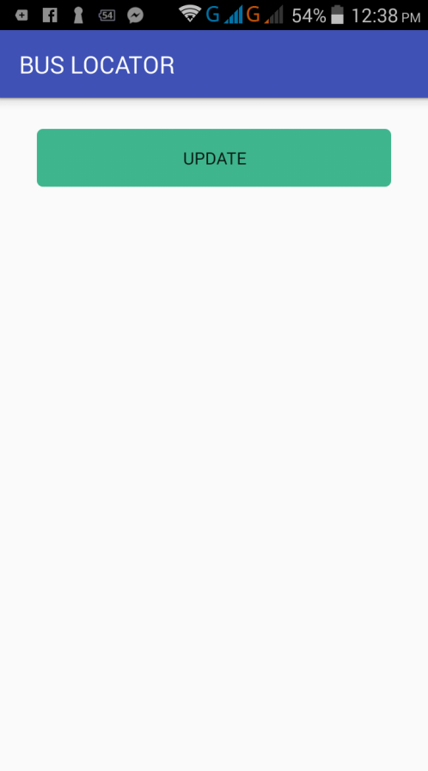
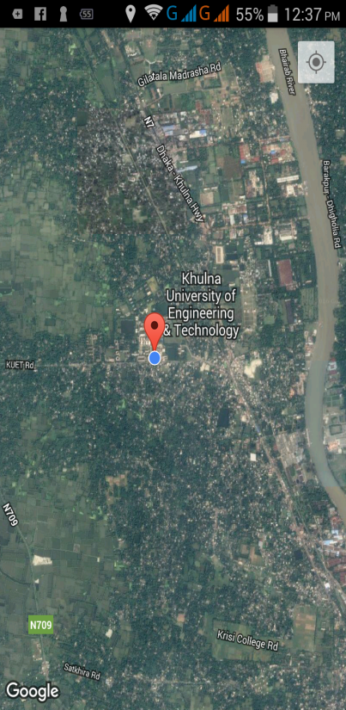
Work Flow & User Interface(4)

Slide 17
Work Flow & User Interface(5)
After updating the location of that particular bus, the general users/passengers can see the bus location and distance of the bus by clicking “SEE BUS” option. There general people will give “Bus Name” and “Bus Route” and can see the distance and bus postion. The interface of this point is in the next slide:

Slide 18

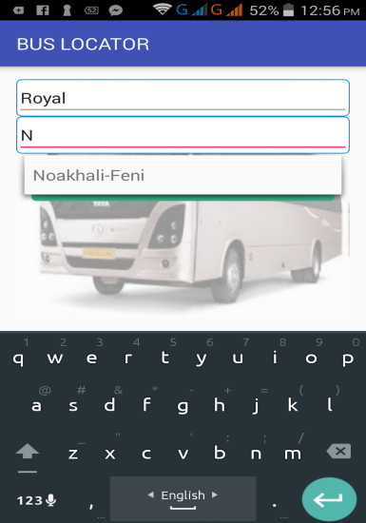
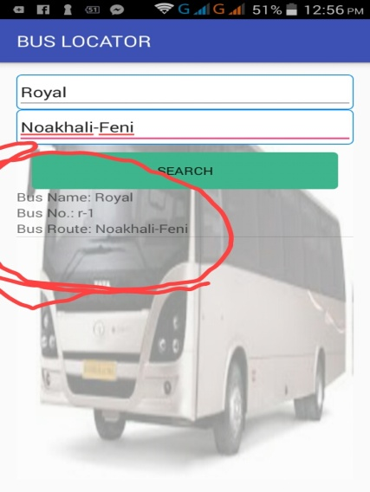
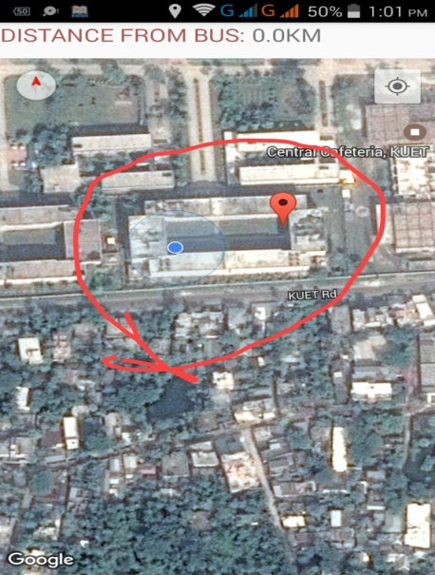
Work Flow & User Interface(6)

Slide 19
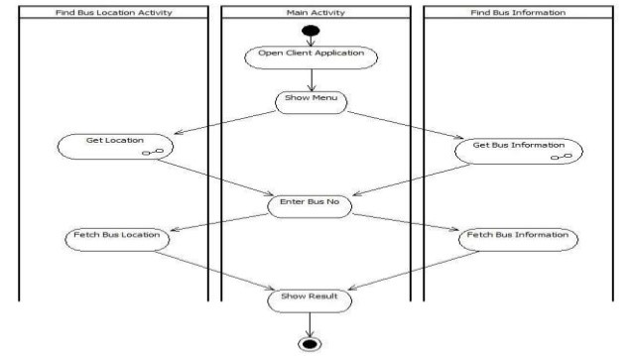
Activity Diagram
The total activity will be like this:

Slide 20
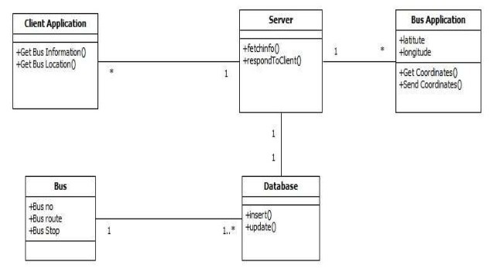
Class Diagram
Class Diagram of the application is given below:

Slide 21
Things To Remember
The Locations can’t be found without adding buses and updating locations.
The bus name, bus no and password will have to be accurate. Otherwise the app will not give any information.
Login is fixed for bus related people only. General people can’t get into the “add Bus” or “Login” option.
The GPS of the android phone must be “ON”.
The location need to be updated after some moments by the bus supervisors to locate the bus in the map.
The distance is measured by using the latitude and longitude and the formula is:
theta= longitude val1 – longitude val2
Distance= sin(latitude1) * sin(latitude2) + cos(latitude2) *cos(theta)
Distance= acos(Distance)
Distance=Distance * 60 * 1.1515
Distance= Distance * 1.609344
(Collected from internet)

